Slide 1
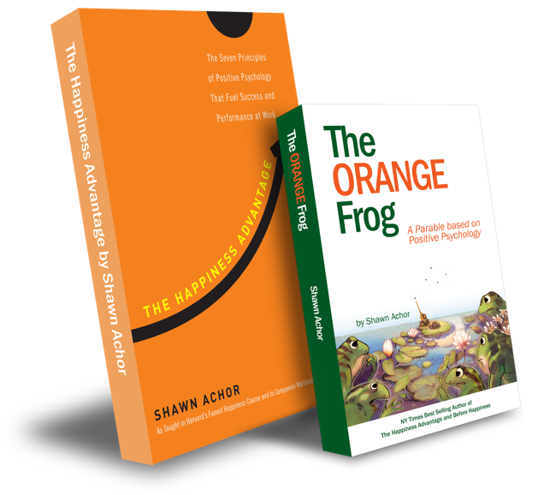
The Doubler

Slide 2
Week Two
The Doubler

Slide 3
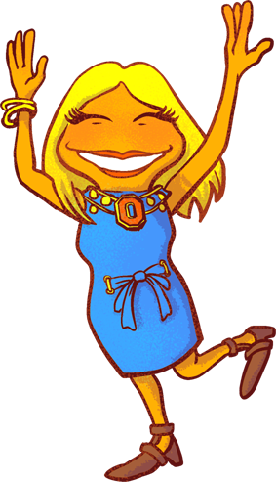
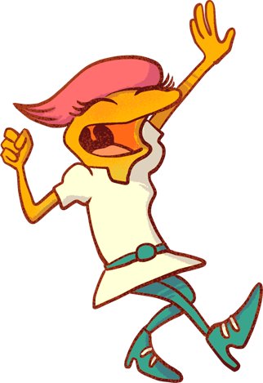
The Doubler
Learning Objective:
I can create a positive mindset through journaling.
I will talk about how important it is to be positive and intentional.
Notes:
Standard:
Essential Concept and/or Skill: Communicate and work productively with others emphasizing collaboration and cultural awareness to produce quality work.
Interact positively as a team member.
Cooperate with others in a group setting.
Generate ideas with group members.
Are active listeners.
Read and understand information in a variety of forms.
Express ideas.
Skill:
Active listening, express ideas

Slide 4
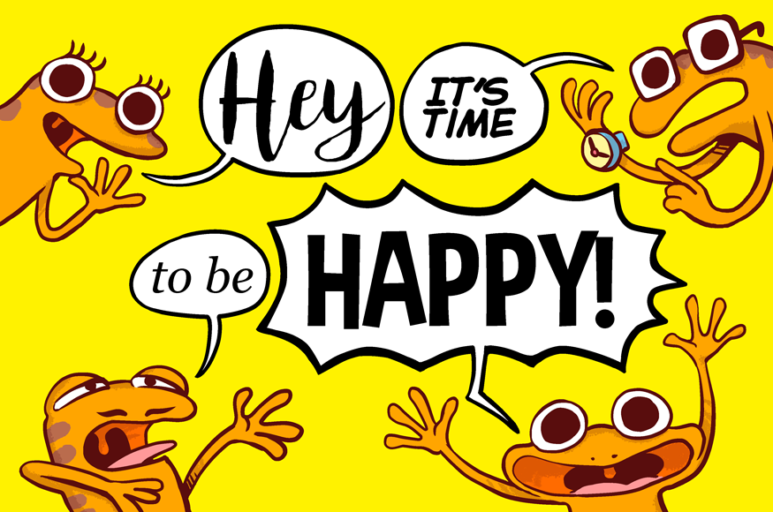
Skills
Communicate clearly
Use information creatively
Opening Questions
What is a positive mindset? OR
Is your mindset positive?

Slide 5
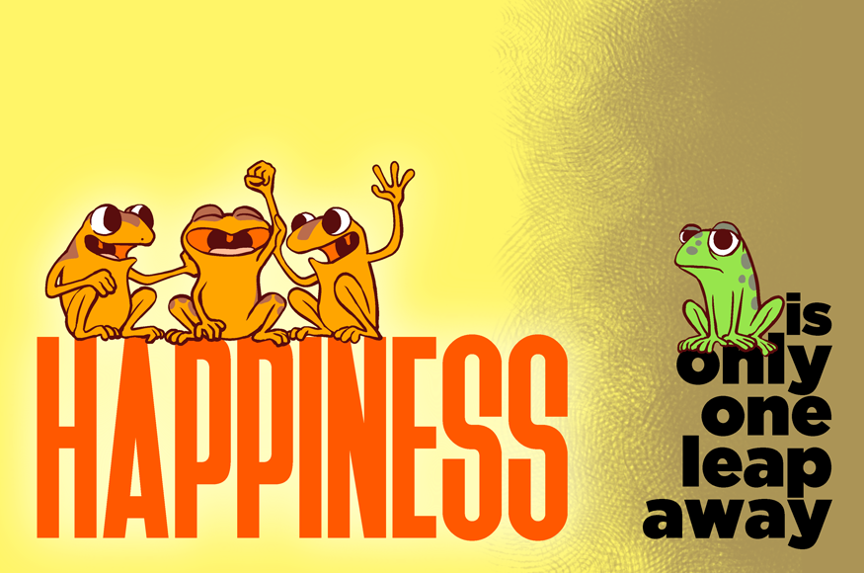
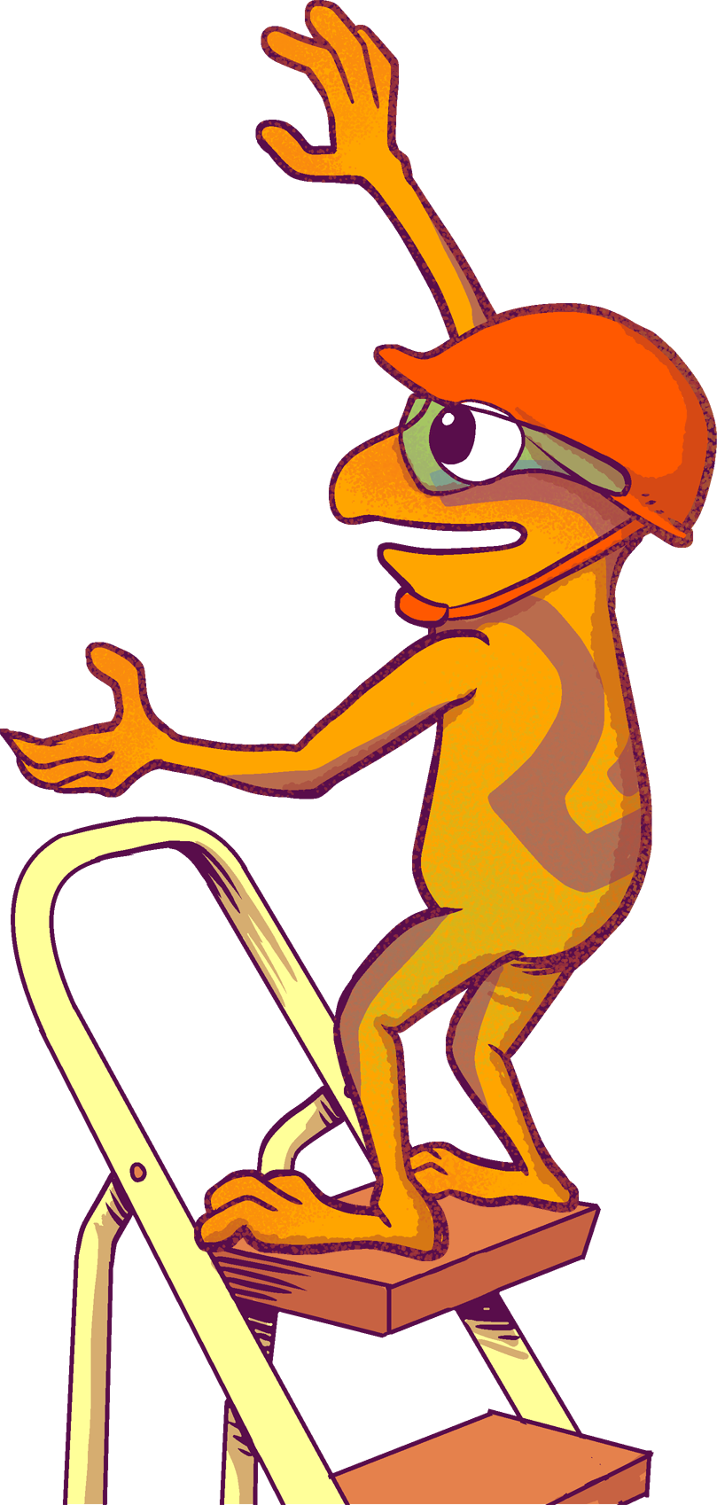
Thoughts for Consideration
A positive mindset is something that sees the good.
Think of it like a pair of glasses. When you have on a pair of positive glasses, you can look at any situation and see the good.
When you have a happy mind, it’s easier to see the good in times when it may be hard, or things aren’t going your way.
Last week we talked about journaling. When we journal our “Doubler” experience, we are asked to look for the good.
We are going to do some self evaluation to see how we feel before we write versus after we write.

Slide 6
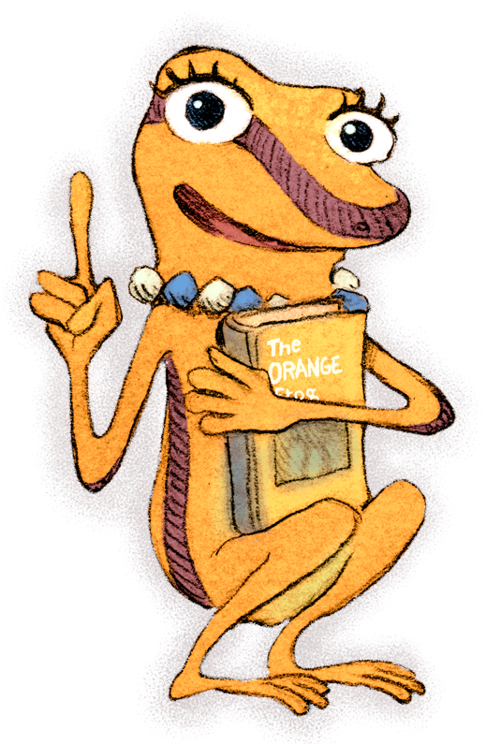
Action
Let’s discuss what you feel before you write versus after you write. Do you think it changes? Does it stay the same? Do you feel more positive?
What would it look like for you to create a self-evaluation form? Would you use a scale? Would you use images? Would you use google forms?
You will create something to use as a tool to determine how you feel before you write versus after you write.

Slide 7
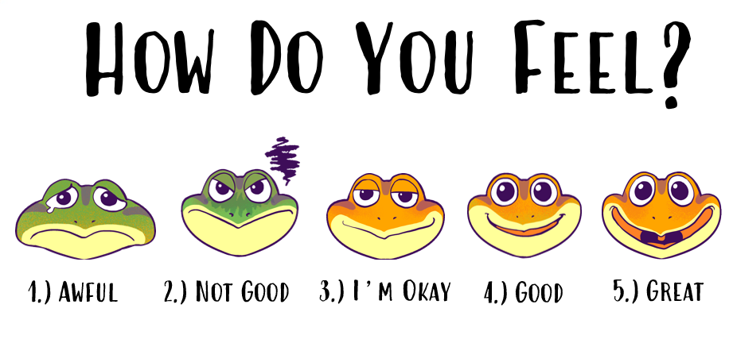
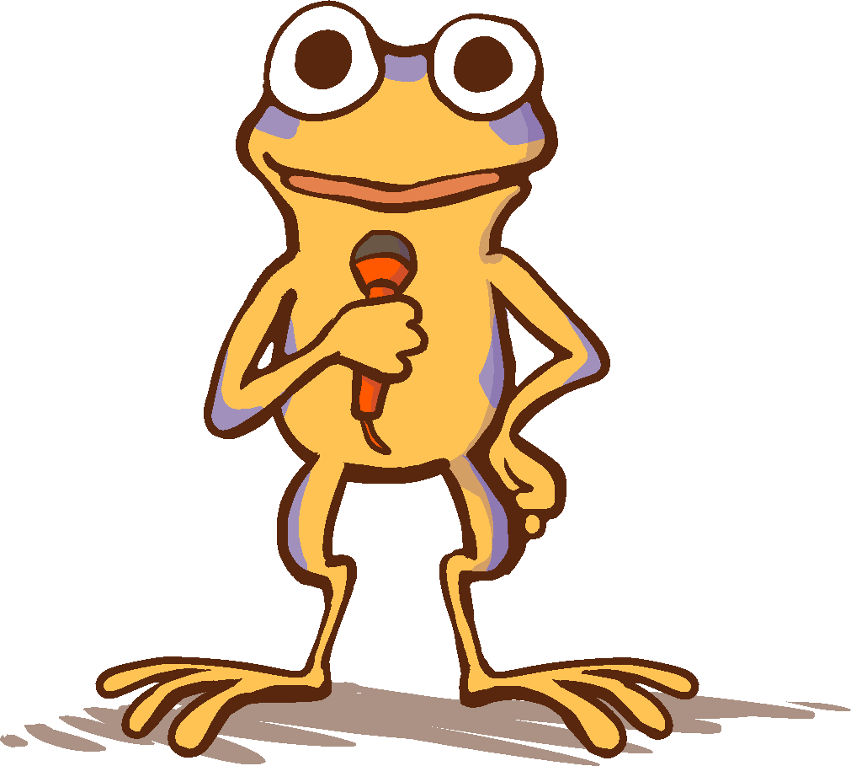
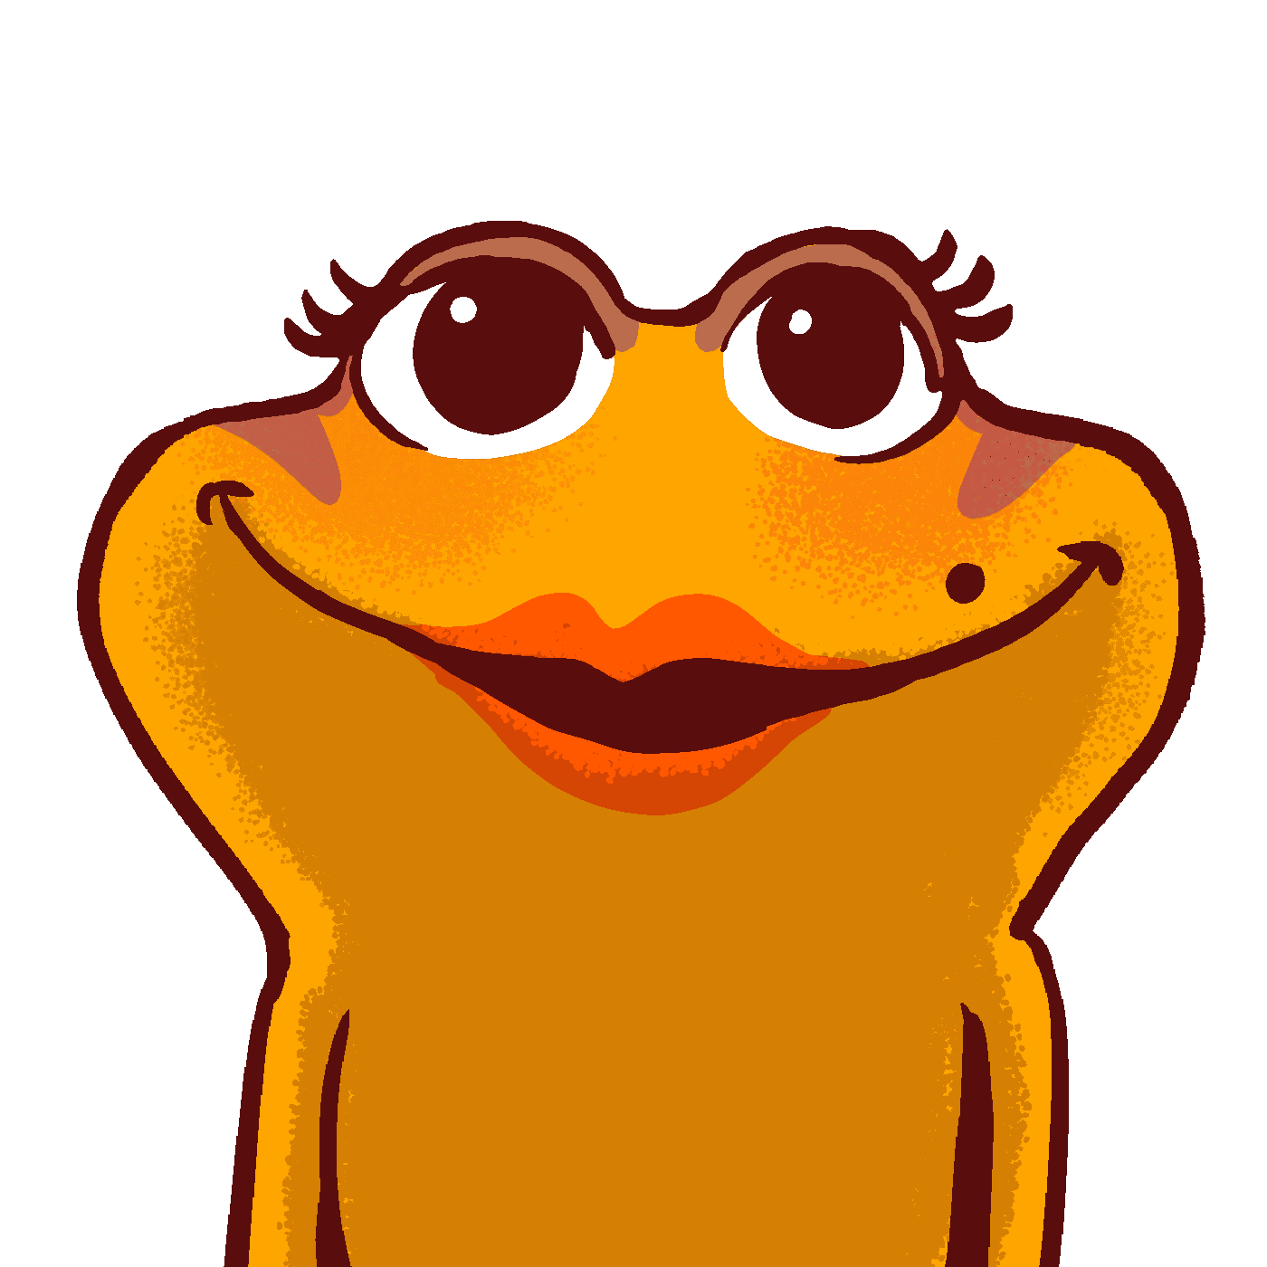
These are examples of what we presented the younger schools with, in order to prompt their self assessments.
Don’t forget, your “Doubler” experience should have three details to describe it and be within the last 24 hours.
Be sure to be honest with yourself about your feelings!

